Slide 1
The history of computers

Slide 2
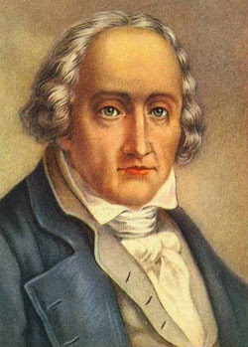
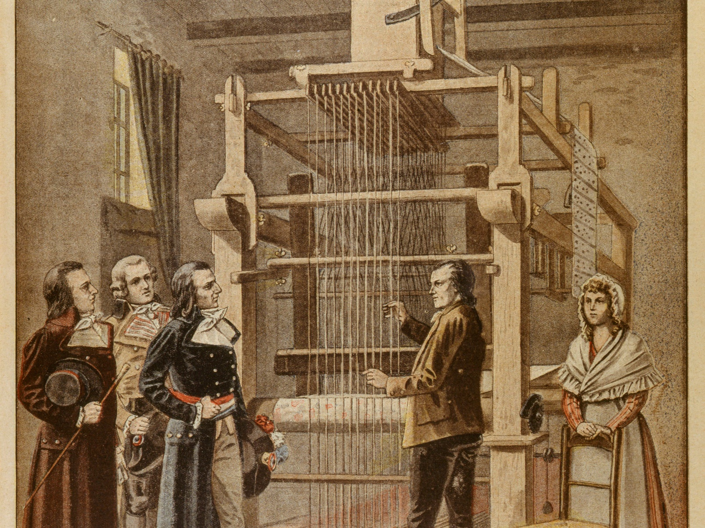
Joseph Jacquard
Jacquard machine - 1801

Slide 3
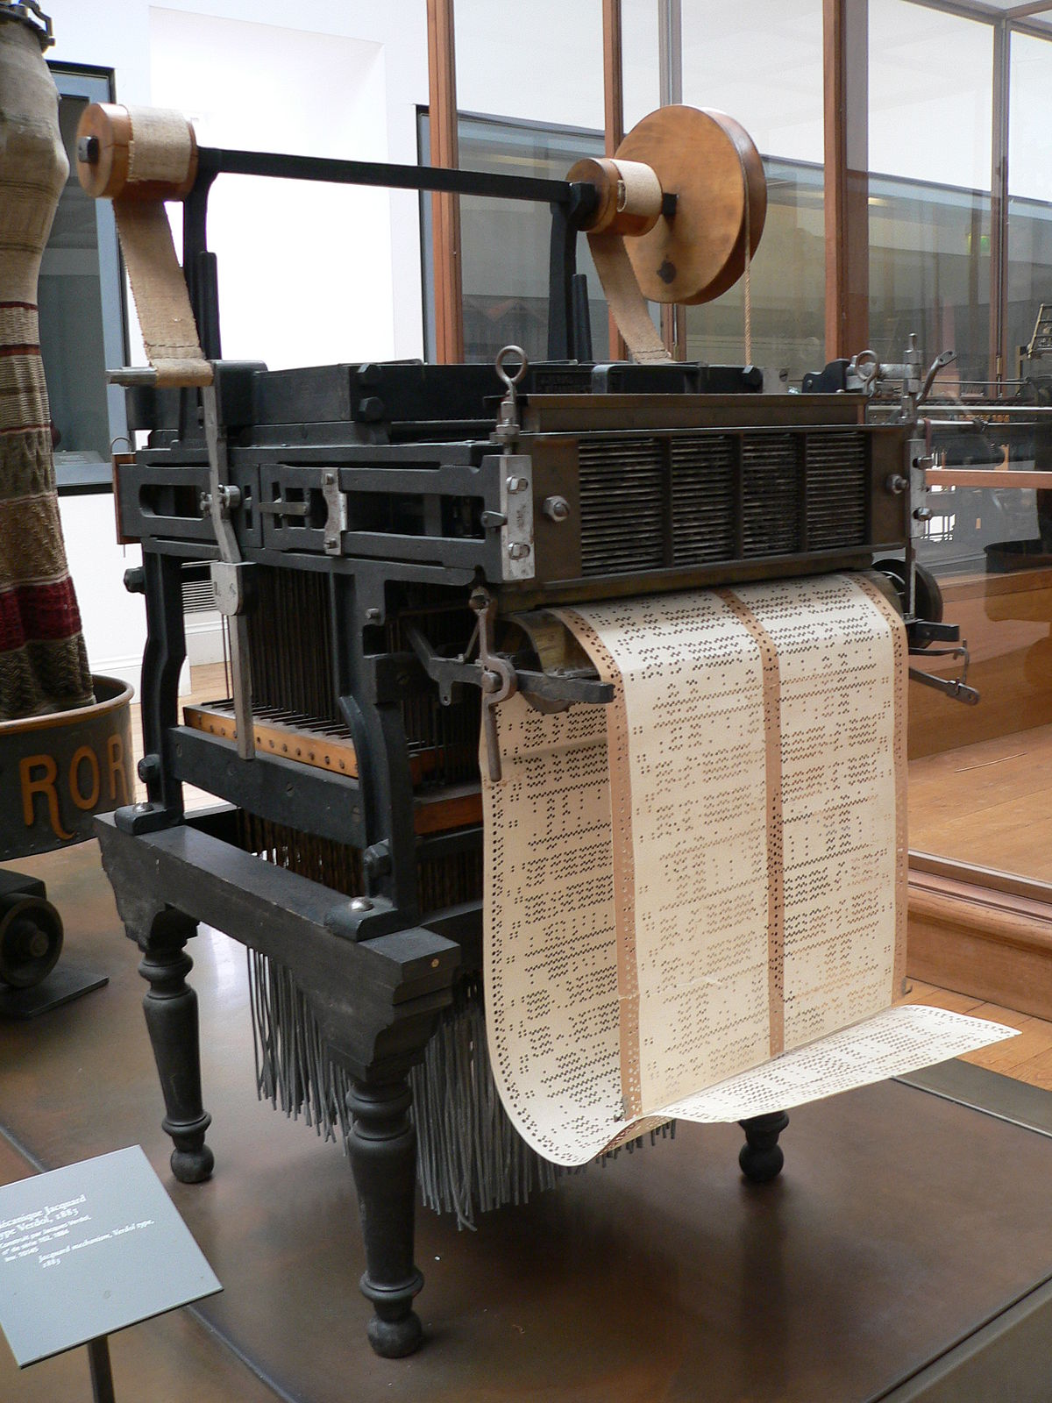
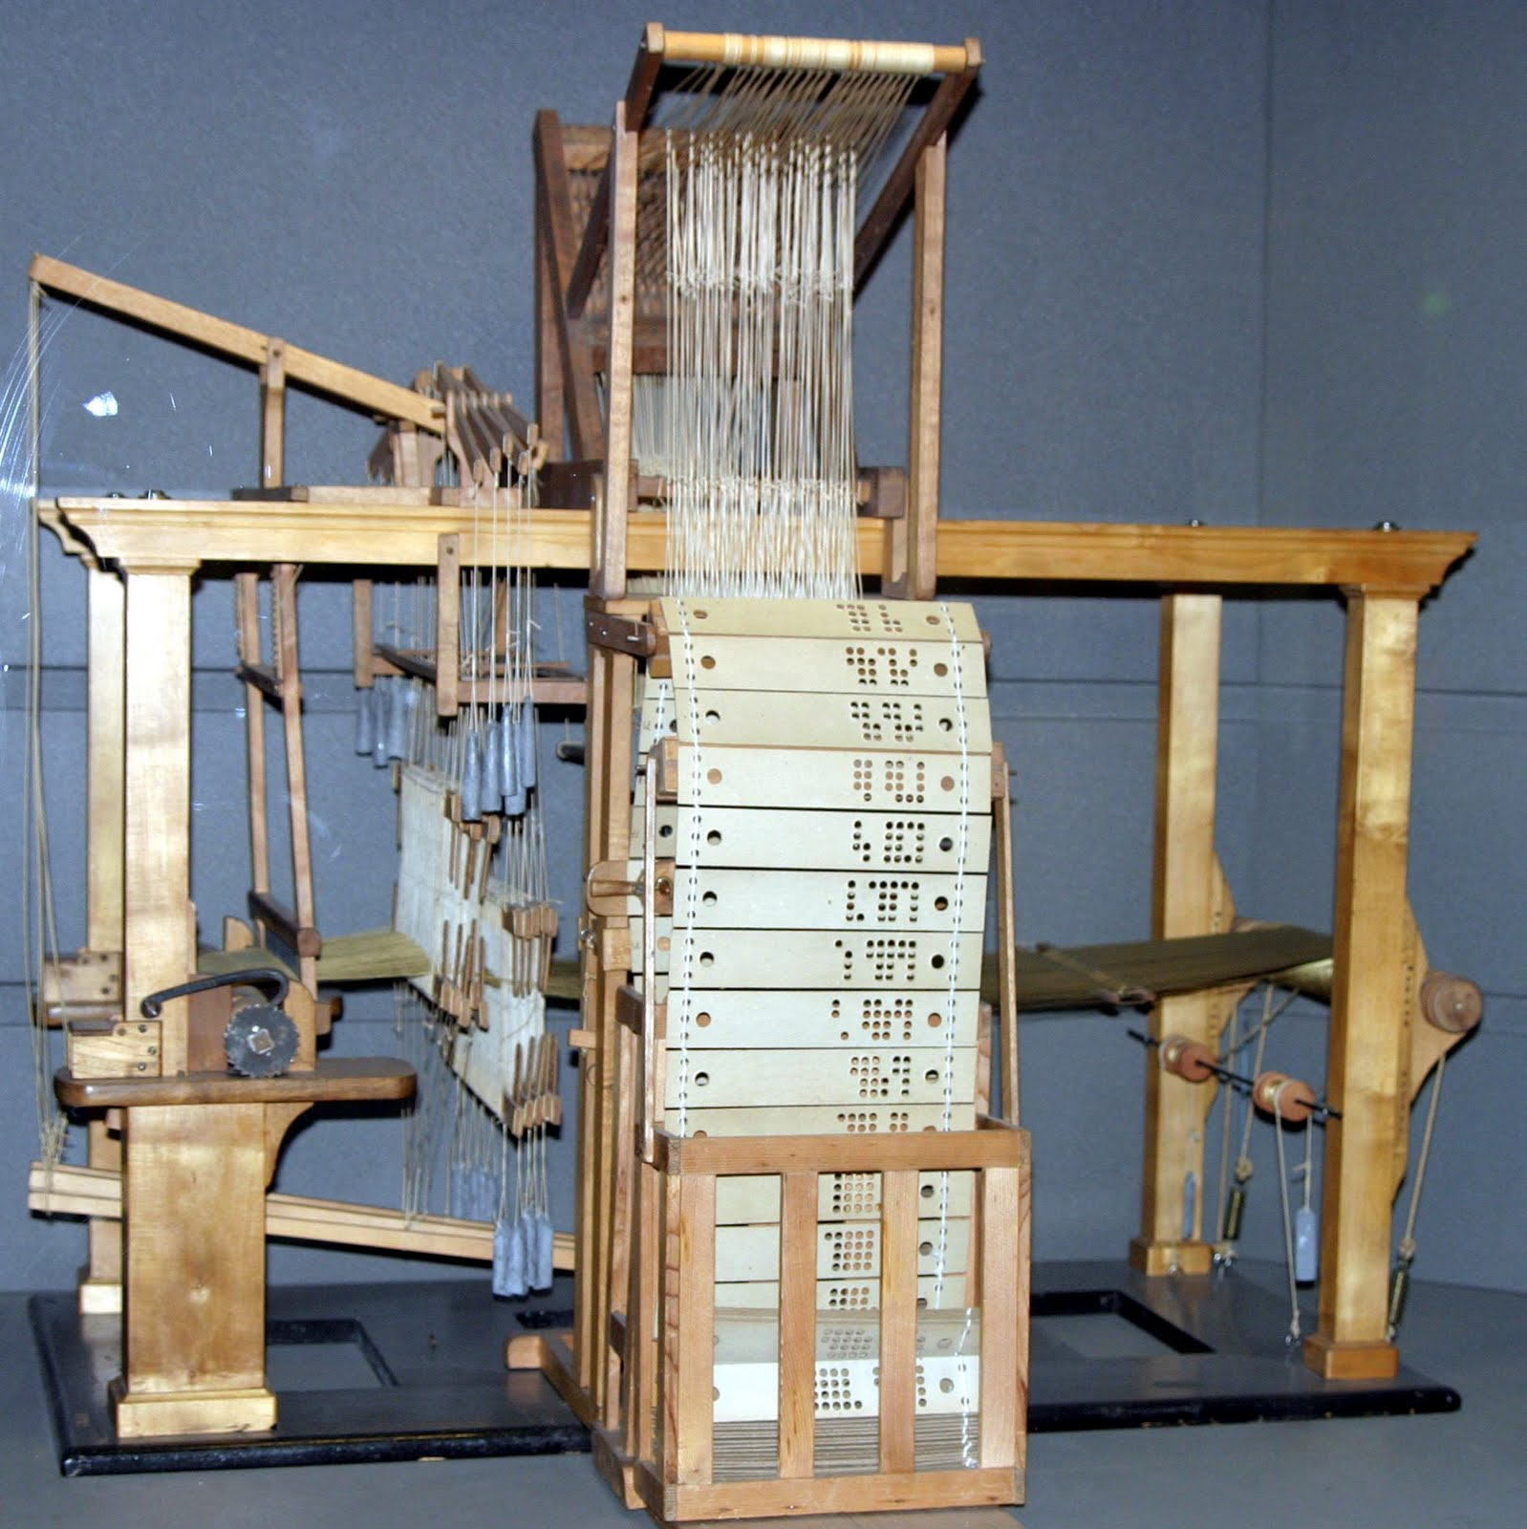

Slide 4
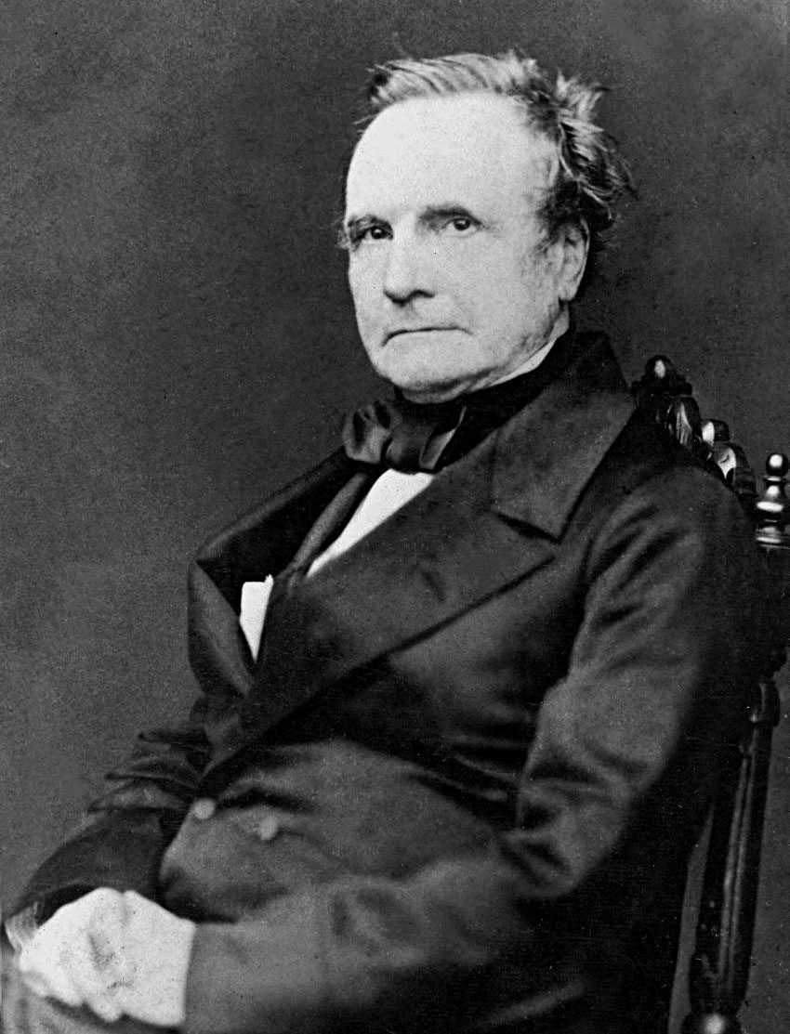
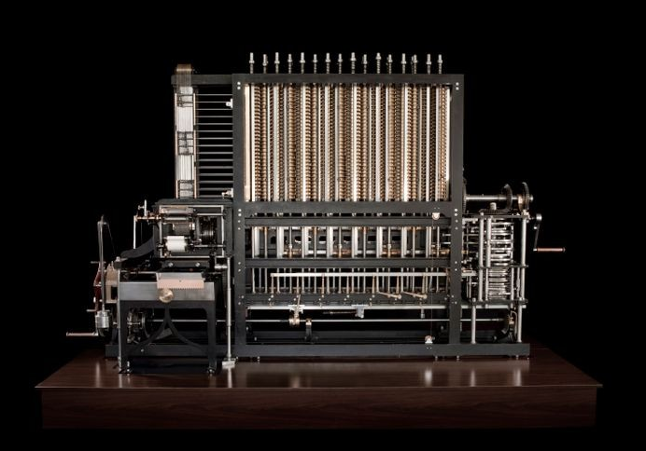
Charles Babbage
Babbage engine - 1822

Slide 5
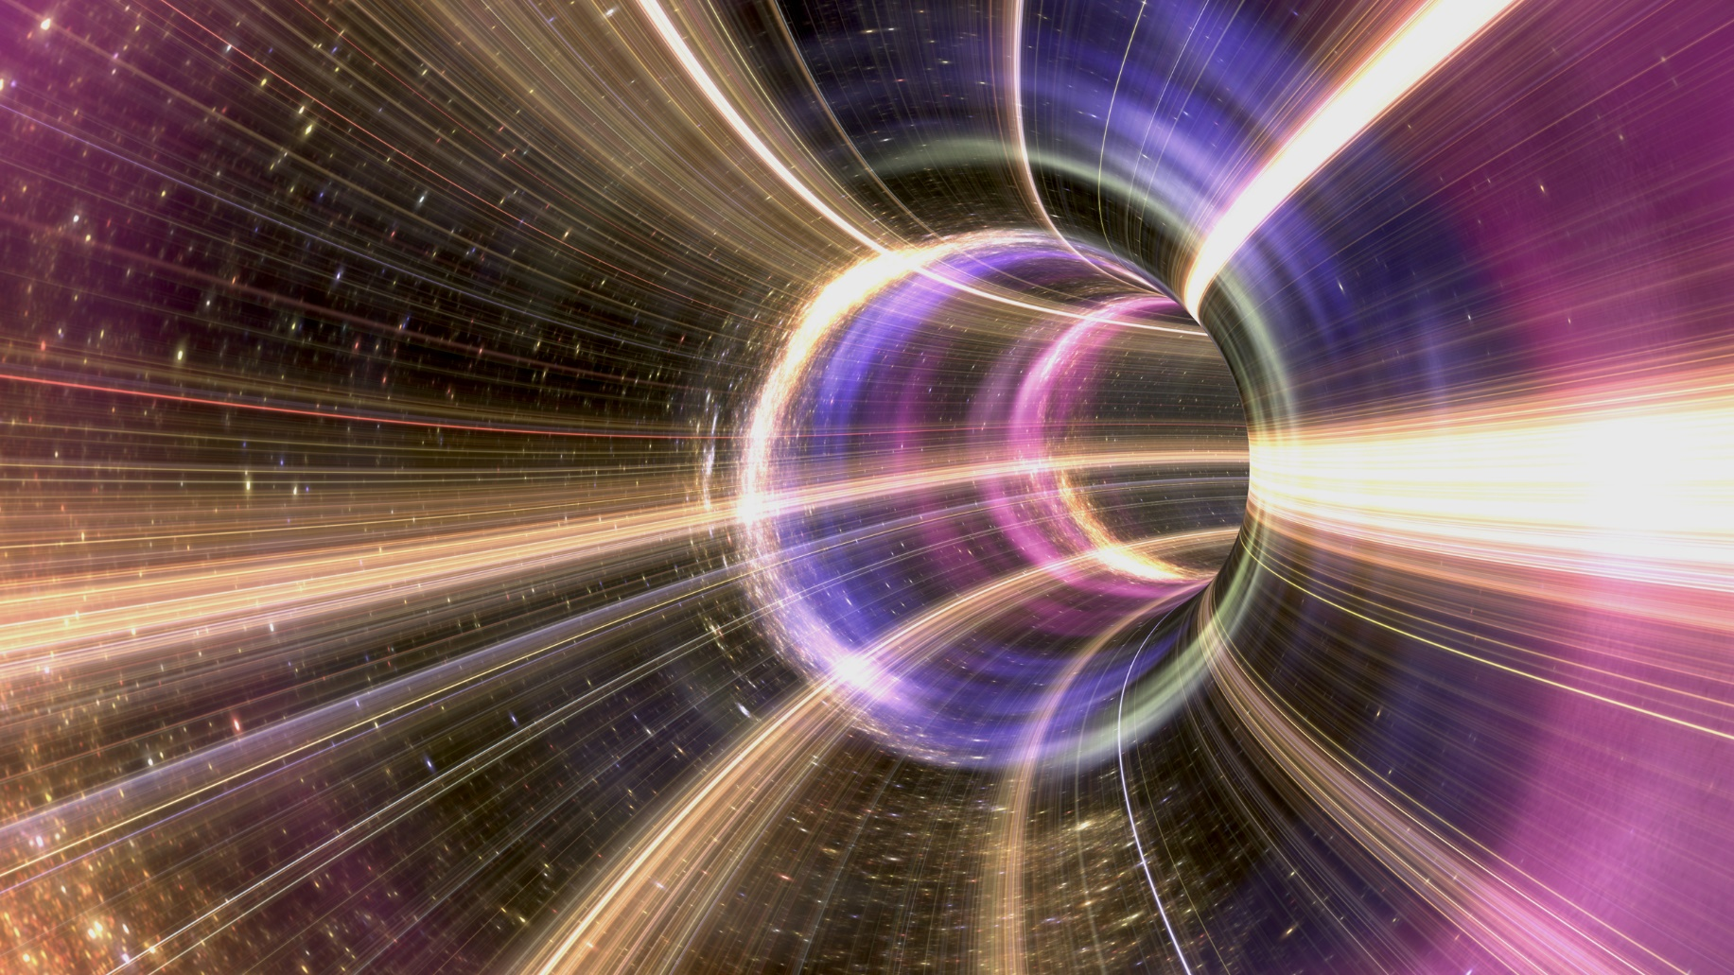

Slide 6
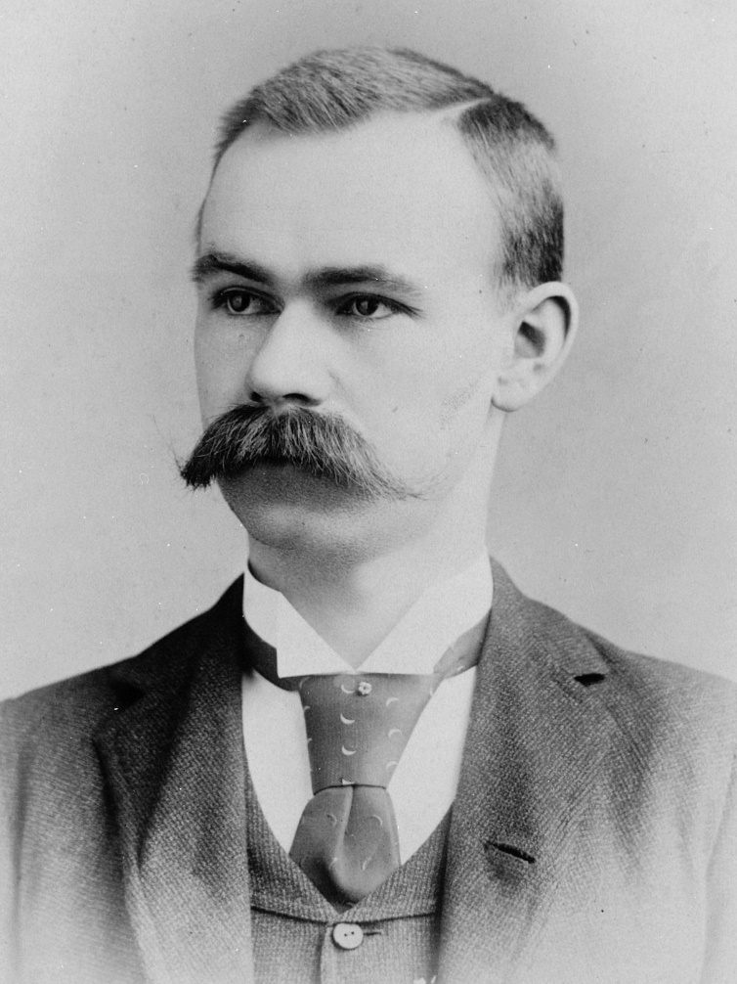
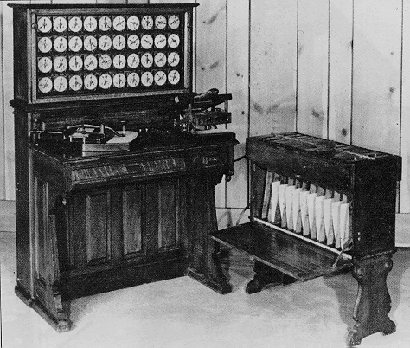
Herman Hollerith
Tabulating machine - 1890

Slide 7
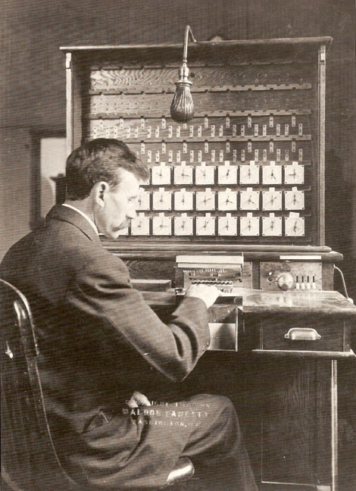

Slide 8
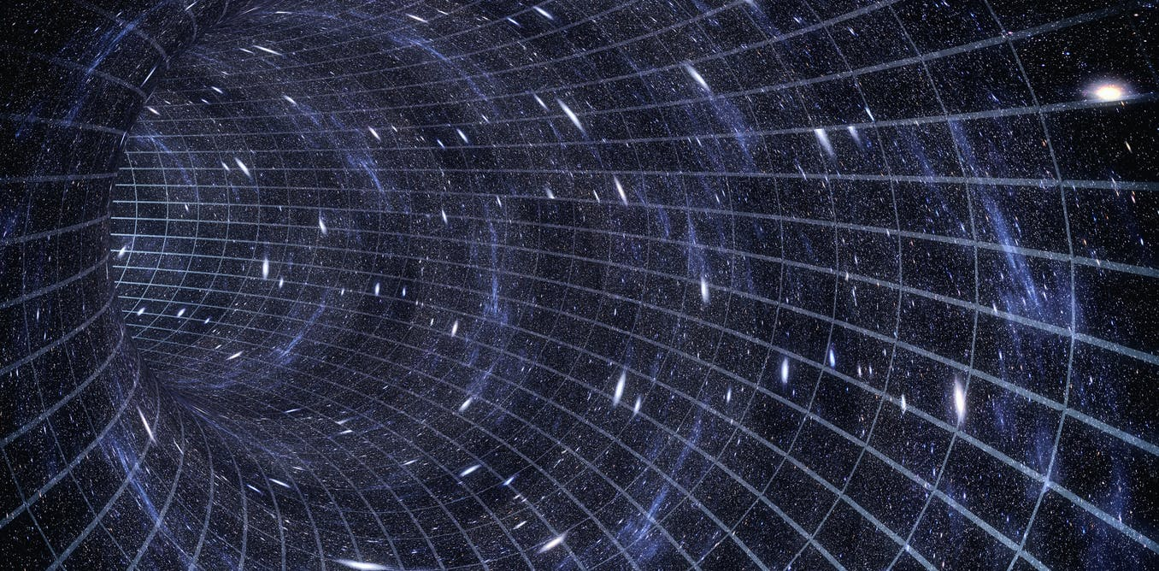

Slide 10

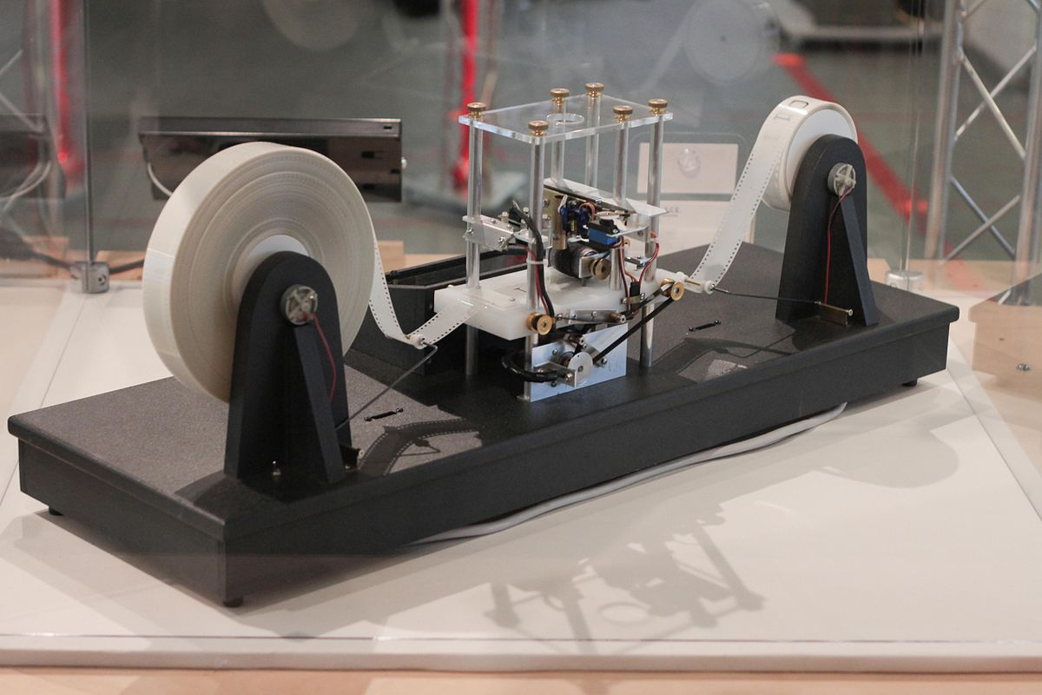
Alan Turing
Turing machine

Slide 11
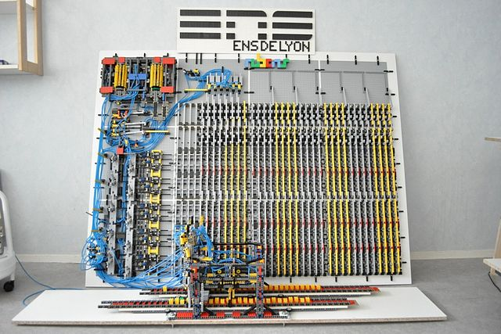

Slide 12
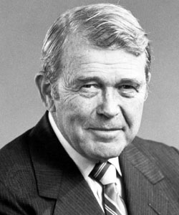
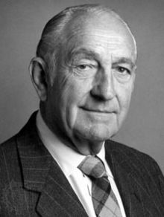

William Hewlett
David Packard
HP Company - 1939

Slide 13
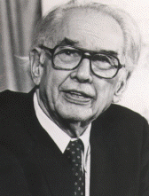
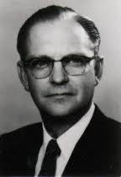
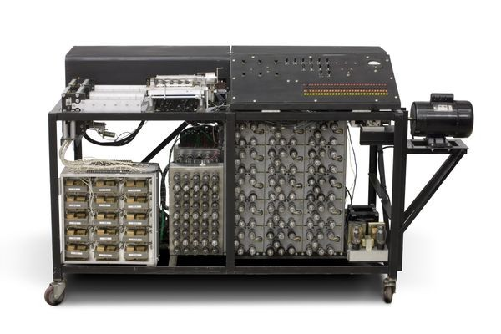
John Atanasoff
Clifford Berry
Atanasoff Berry Computer - 1941

Slide 14
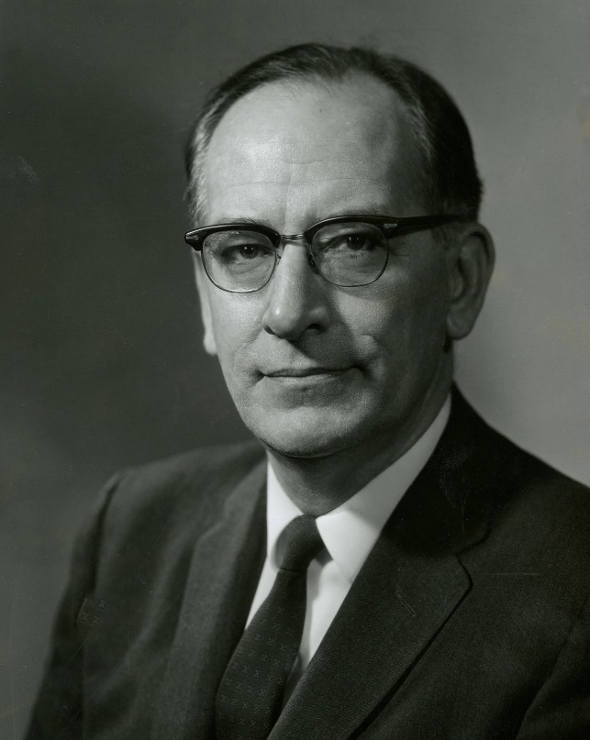
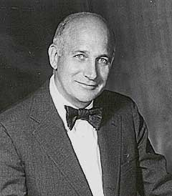
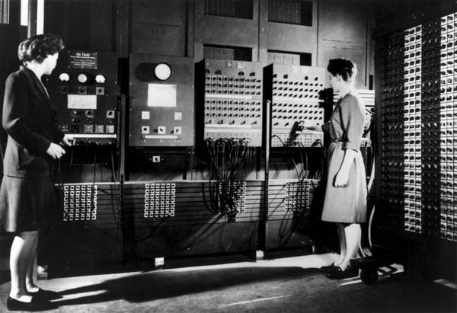
John Mauchly
John Eckert
ENIAC - 1944

Slide 15
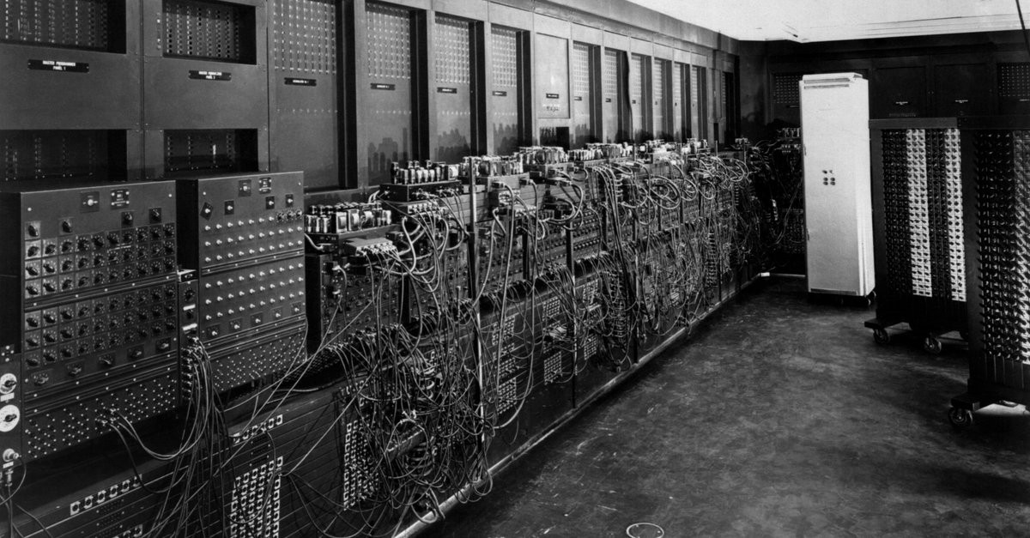

Slide 16
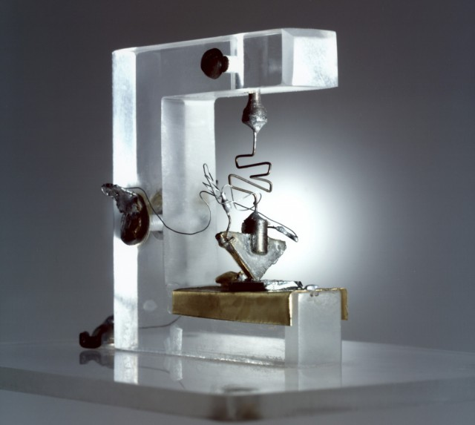
The transistor - 1947

Slide 17
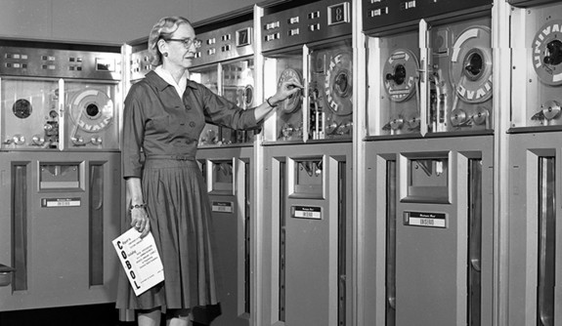


Grace Hopper

Slide 18
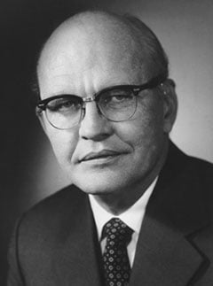
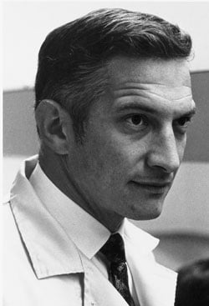
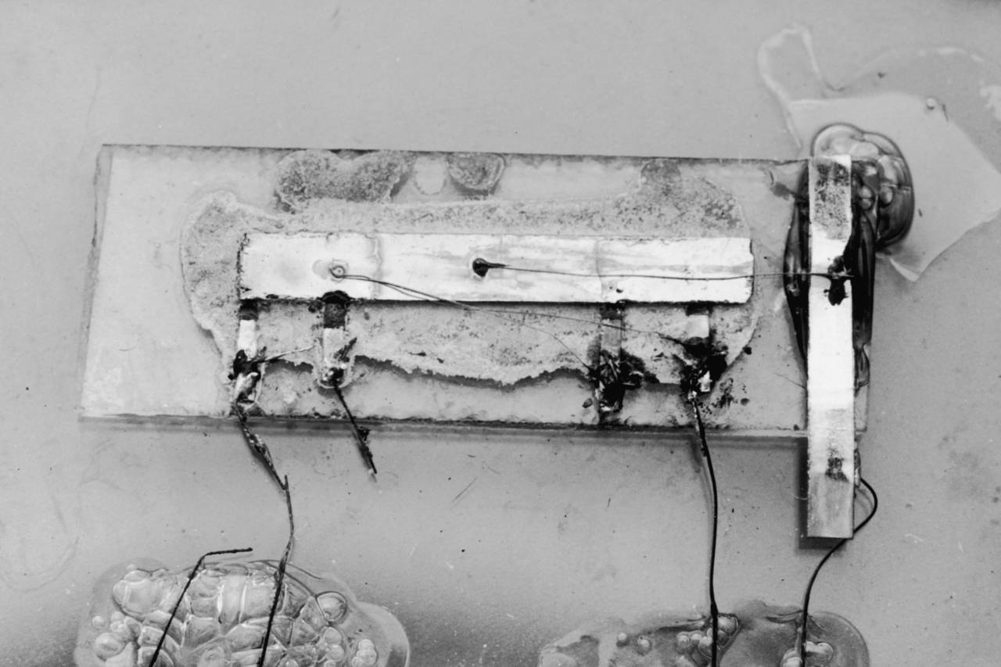
Jack Kilby
Robert Noyce
Computer chip - 1958

Slide 19
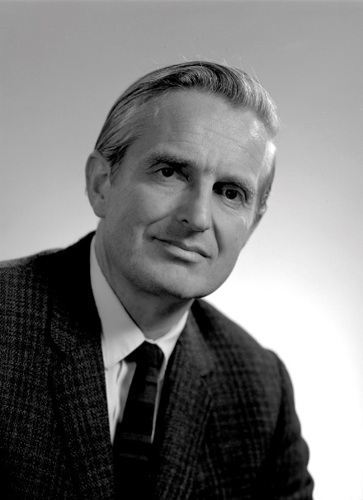
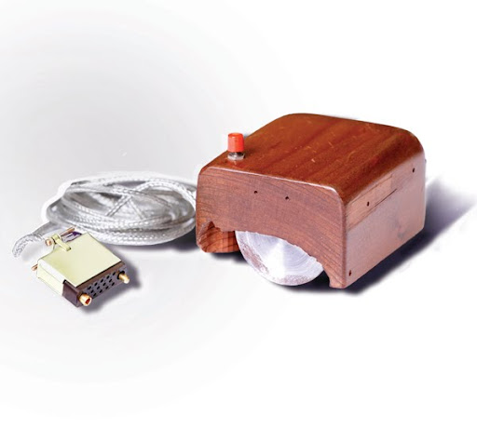
Douglas Engelbart
Computer mouse - 1964

Slide 20

1969

Slide 21
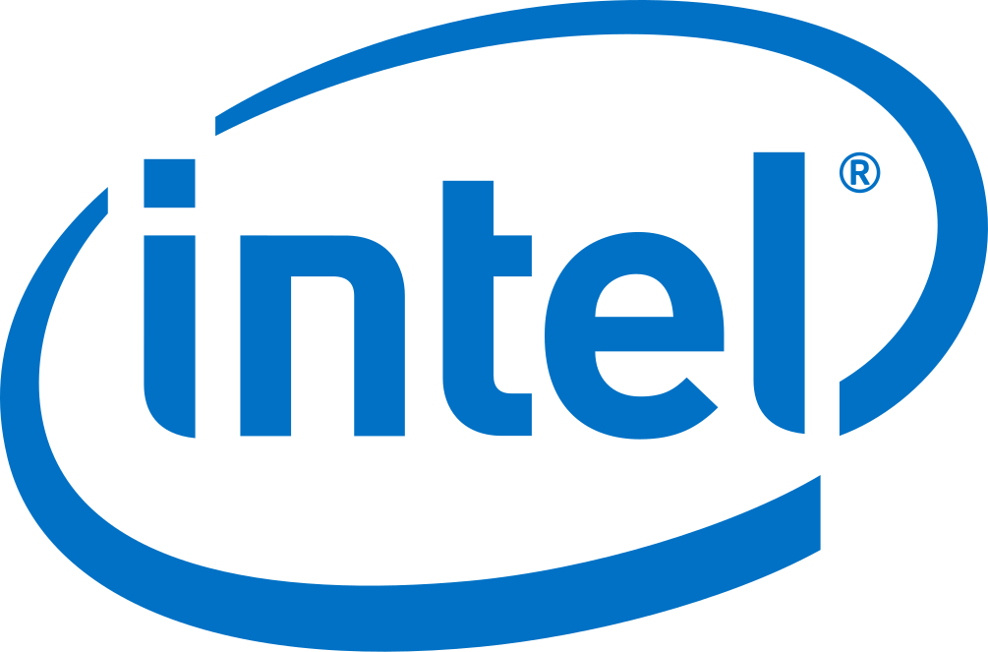
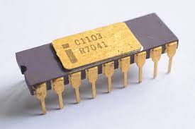
First DRAM chip - 1970

Slide 22
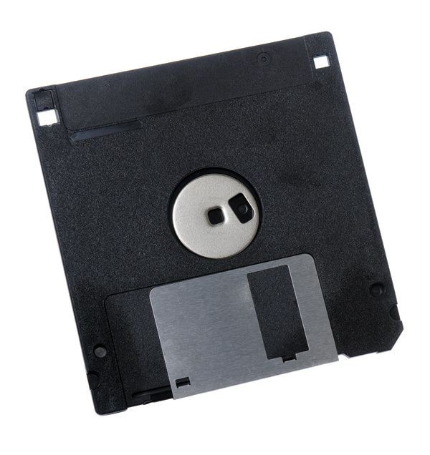

Slide 23
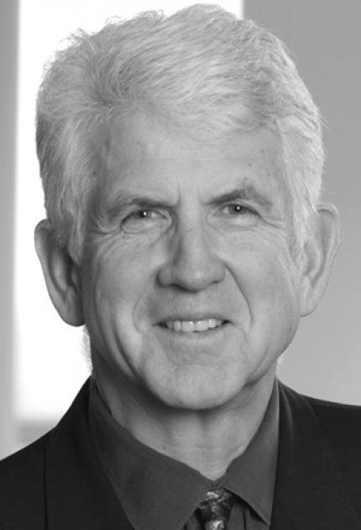
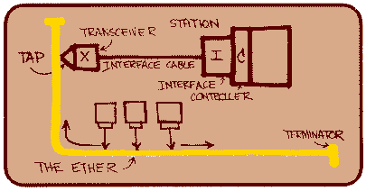
Ethernet - 1973
Robert Metcalfe

Slide 24
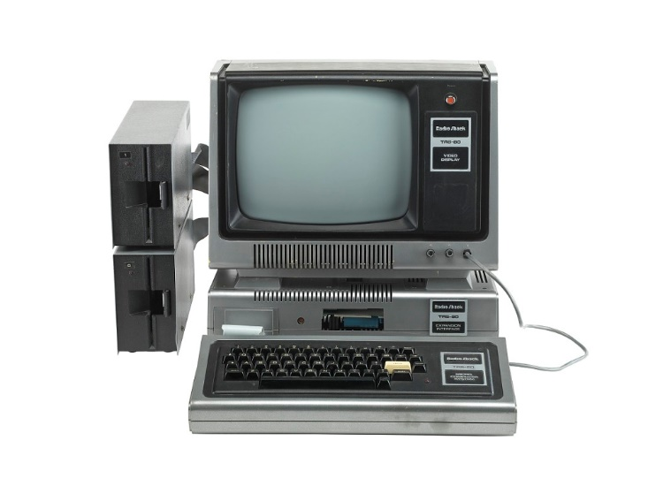
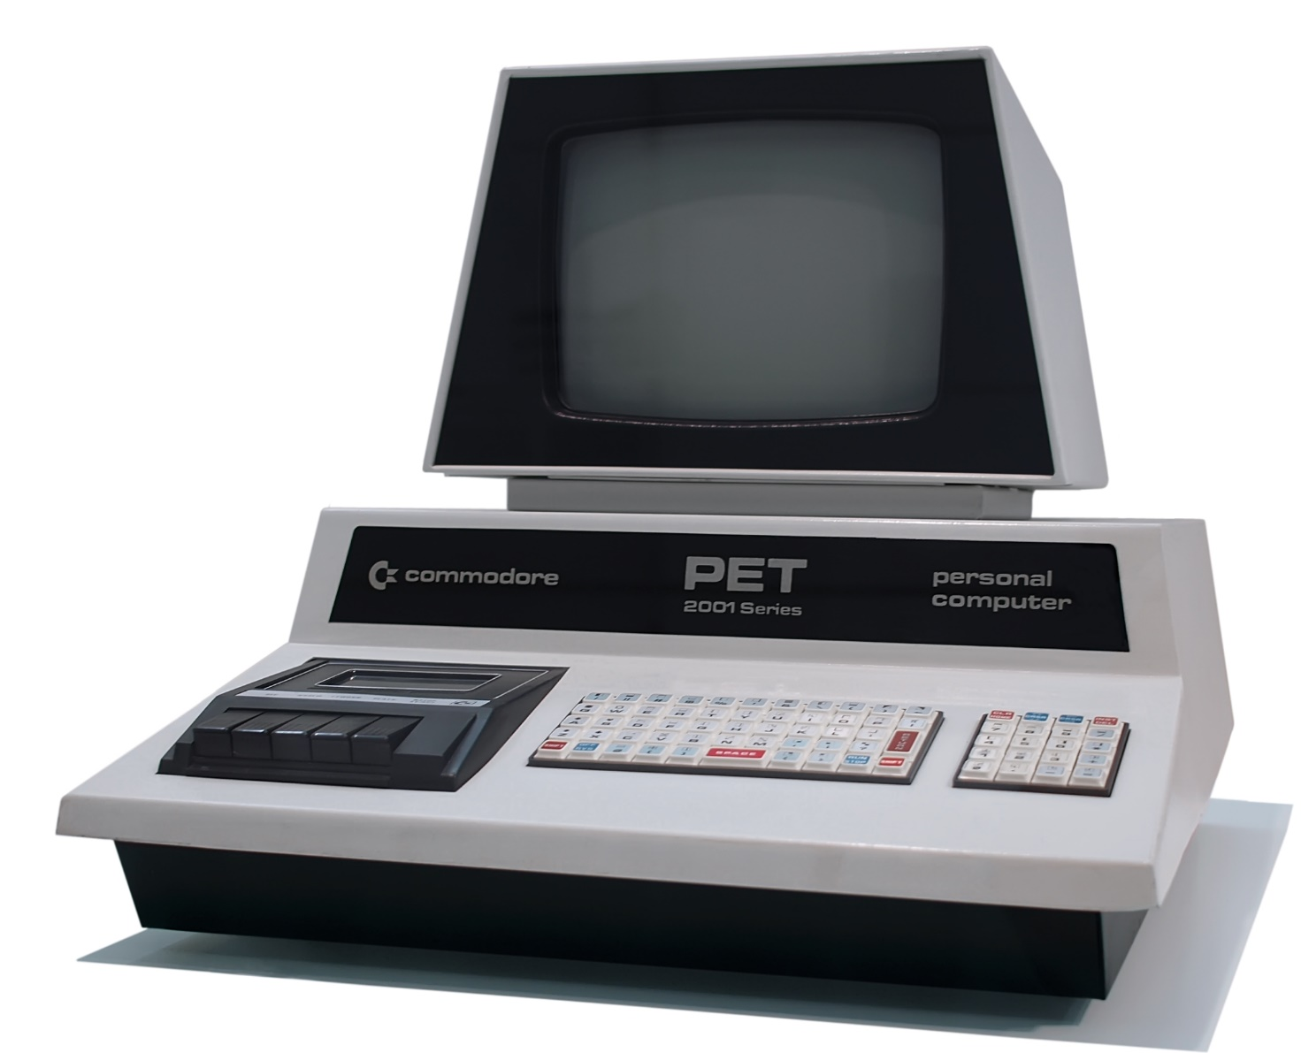
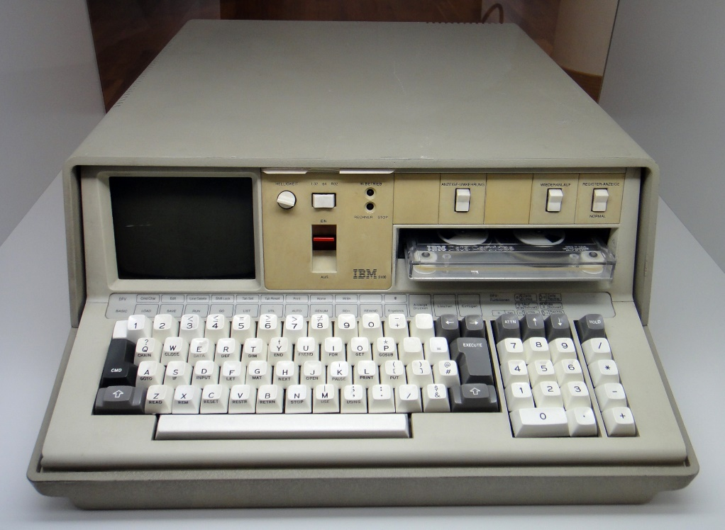
Commodore Pet
IBM 5100
“Trash 80”

Slide 25
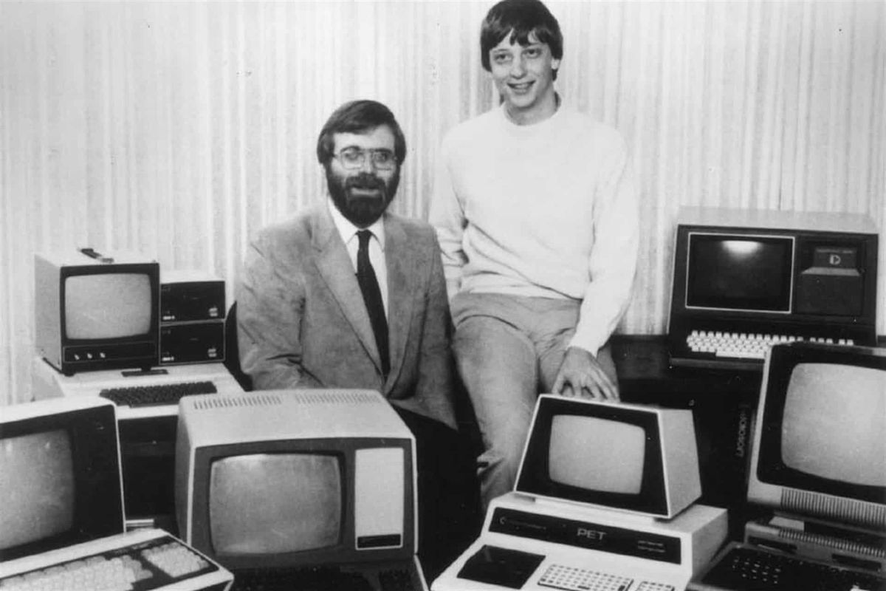

Paul Allen and Bill Gates
Microsoft - 1975

Slide 26
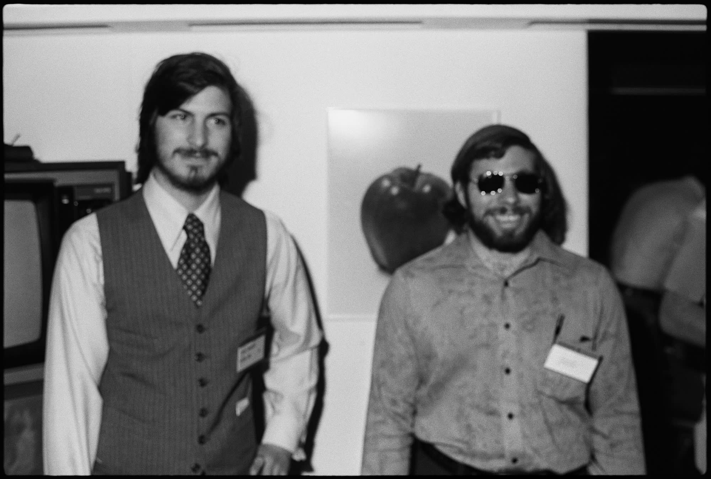
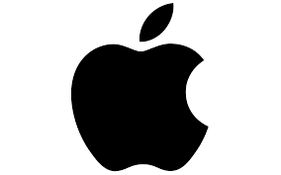
Steve Jobs and Steve Wozniak
Apple - 1976

Slide 27
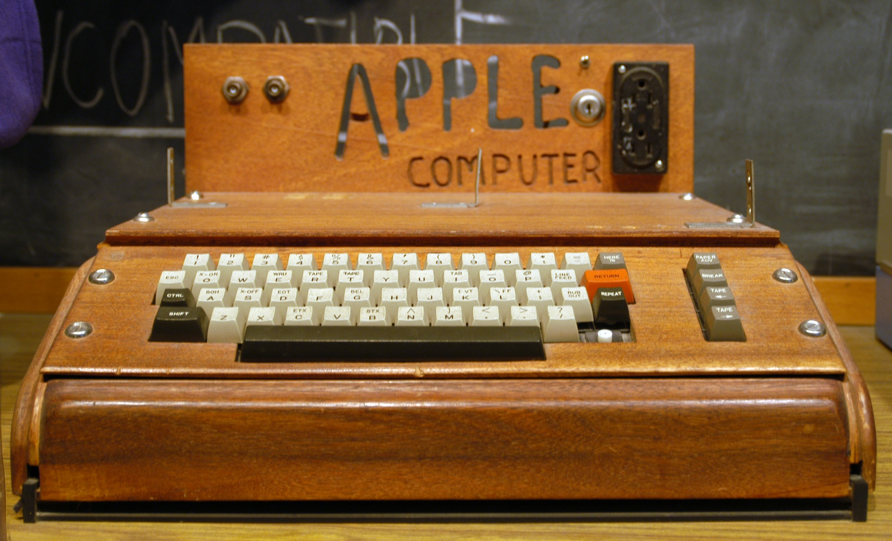

Slide 28
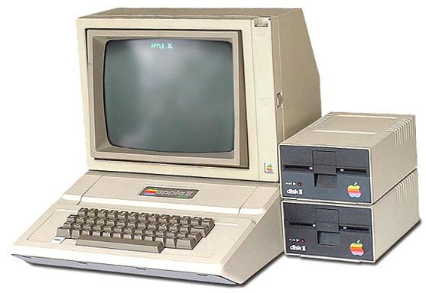

Slide 29
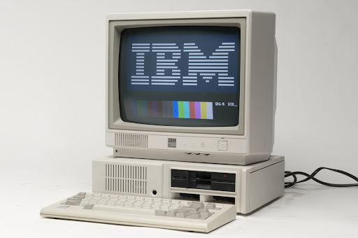
First personal computer - 1981

Slide 30
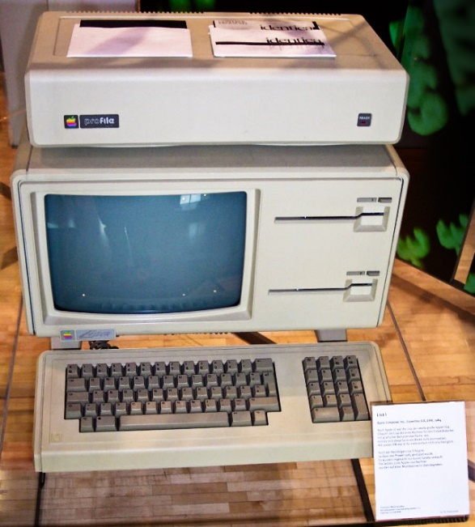
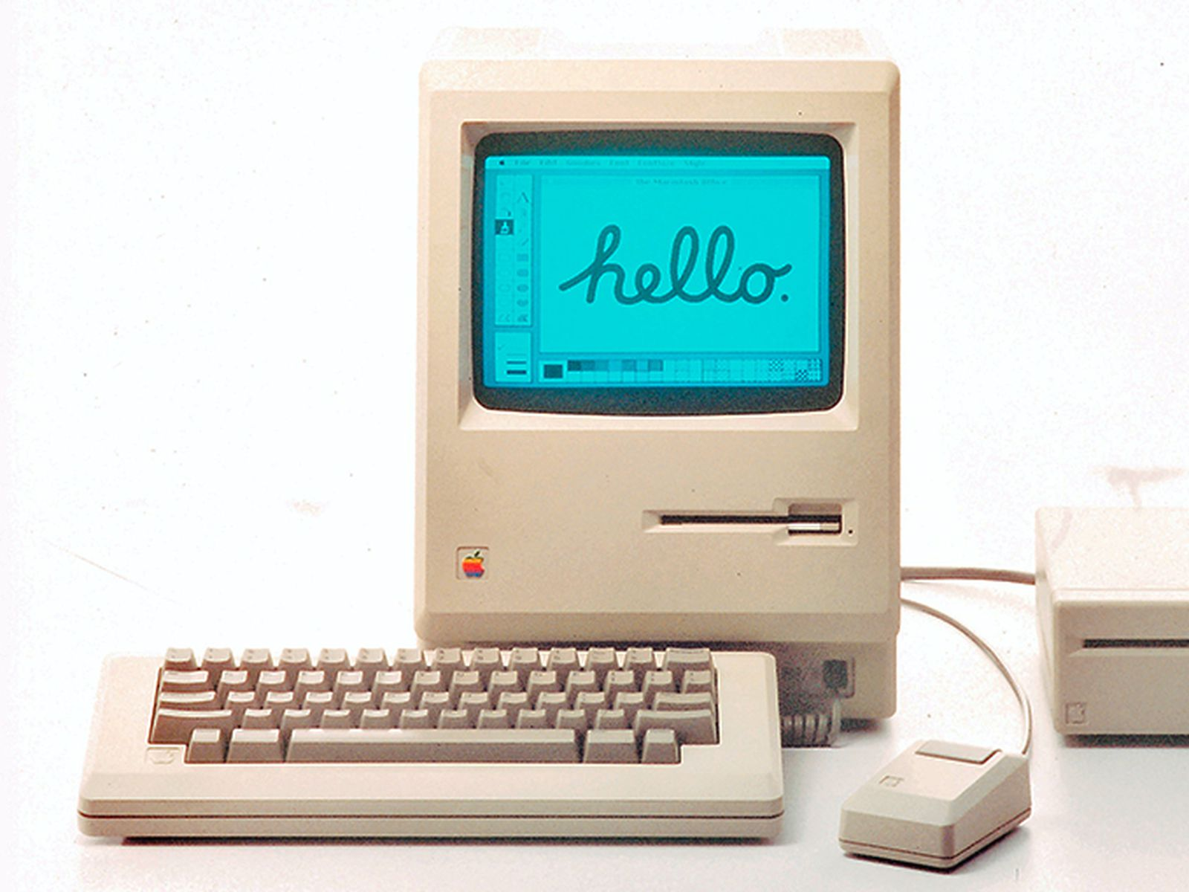

“Lisa” - 1983
Macintosh

Slide 31

Windows - 1985

Slide 32
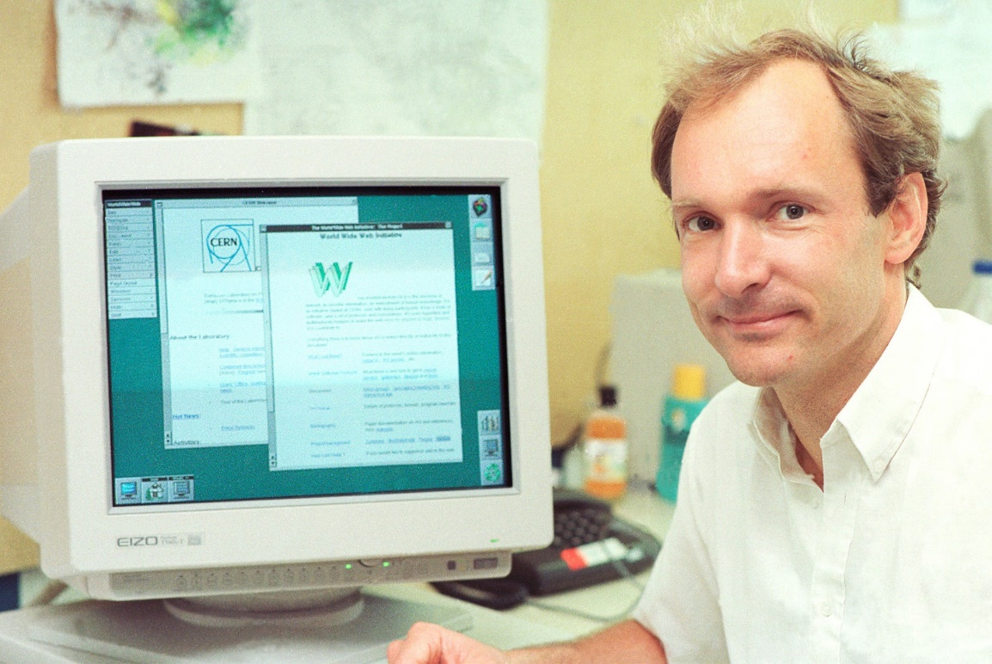

Tim Berners-Lee
HTML - 1990

Slide 33


Slide 34
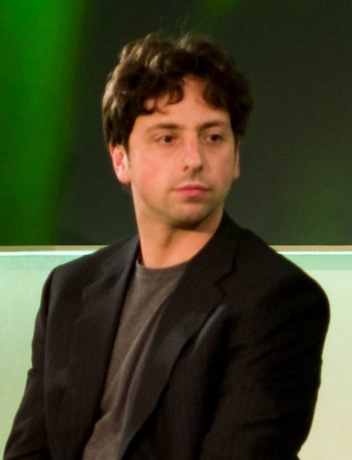
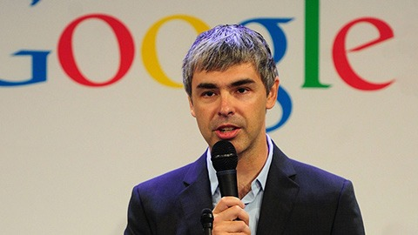
Sergey Brin
Larry Page
Google - 1996

Slide 35

Wi-Fi - 1999

Slide 36
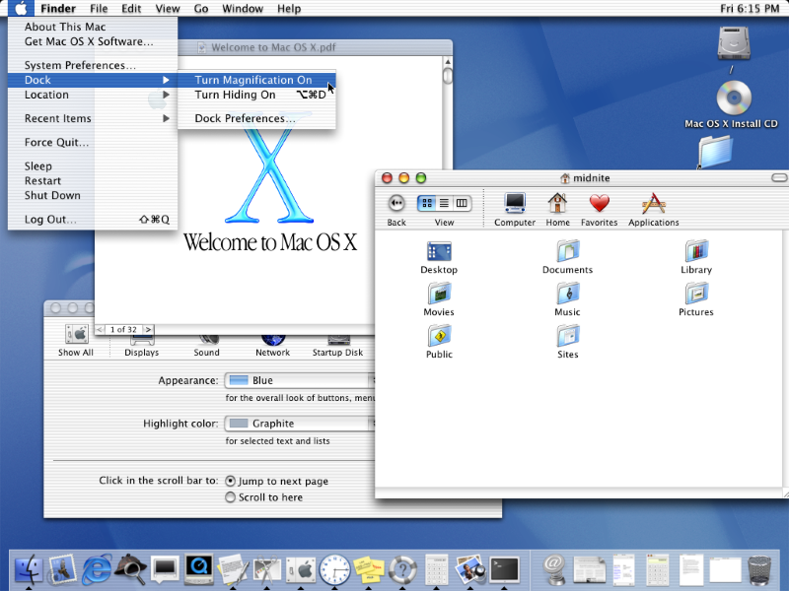
Mac OS X - 2001

Slide 37
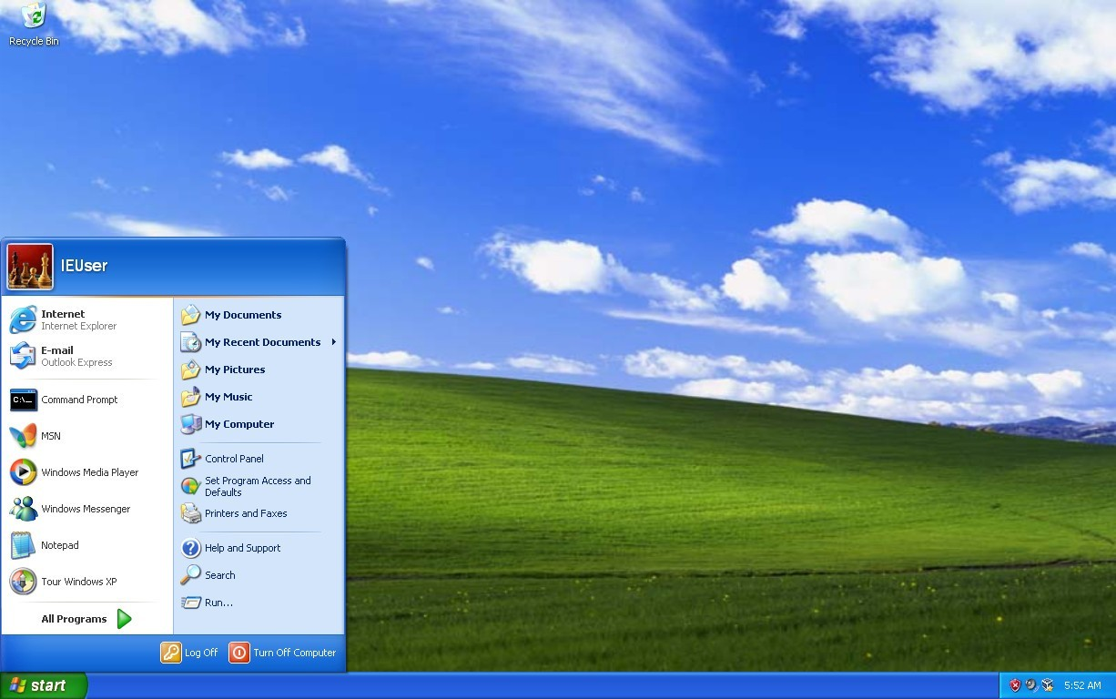
Windows XP - 2001

Slide 38

Facebook - 2004

Slide 39

YouTube - 2005

Slide 40



Slide 41

194 million humans:

Slide 42


Slide 43

iPhone - 2007

Slide 44

Windows 7 - 2009

Slide 45

Windows 10 - 2015

Slide 46

First reprogrammable quantum computer - 2016

Slide 48


Slide 49


